Slide 1
Comparison of Fentanyl and Morphine in the prehospital treatment of ischemic type chest pain

Slide 2
Introduction
Ischemic-type chest pain is the most common chief complaint resulting in transport to a hospital.
In ACS, sympathetic stress and catecholamine release is associated with myocardial irritability, arrhythmia, and infarct size.
Analgesia is achieved with either fentanyl or morphine.
Fentanyl may be a better option than morphine in the pre-hospital setting.
The goal of this study is to evaluate fentanyl as a superior analgesic for ischemic chest pain in the pre-hospital setting.

Slide 3
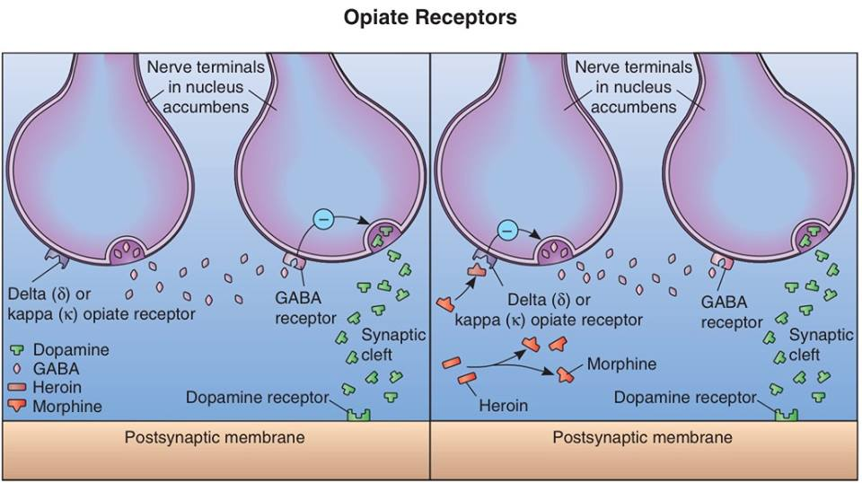
Pathophysiology
 | Morphine | Fentanyl
Individual Dose | 2.5 to 5 mg every 5 minutes | 25 to 50 mcg every 5 minutes
Maximum Dose | 20 mg | 200 mcg
Class | Opioid Analgesic | Synthetic Opioid Analgesic
Onset/Duration | Minutes to Hours | Seconds to Minutes
Side Effects | Respiratory depression, headache, nausea, hypotension. | Respiratory depression, hypotension, chest wall rigidity.

Slide 4
Methods
Double-blind randomized controlled trial of morphine vs. fentanyl in the treatment of ischemic-type chest pain in the pre-hospital setting.
Ischemic chest pain occurs when the heart muscle (myocardium) receives insufficient blood flow.
Medications were provided in preloaded syringes by an outside pharmacy for a total volume of 8 mL.
Morphine was dosed at 2.5 mg per 1 mL. (Max dose of 20 mg.)
Fentanyl was dosed at 25 mcg per 1 mL. (Max dose of 200 mcg.)

Slide 5
Criteria
Inclusion:
Over 18 years old.
Systolic BP ≥100 mmHg.
Initial SpO2 ≥95%.
Exclusion:
Known pregnancy.
Cognitive impairment.
Known allergy to either medication.
Traumatic injury.
Right ventricular infarct.
Eligibility:
Ischemic chest pain not relieved by oxygen, aspirin or nitro.

Slide 6
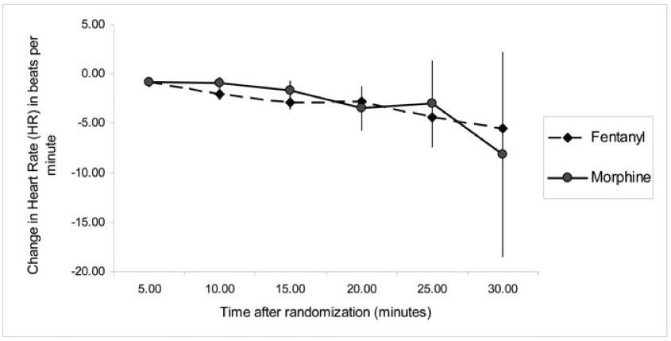
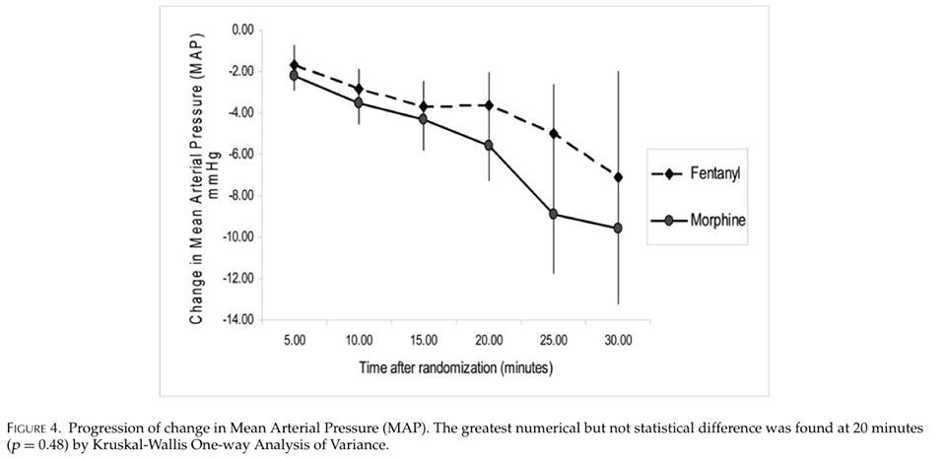
Results and Discussion
Fentanyl:
Ideal agent.
Immediate onset.
No episodes of apnea.
Superior analgesic.
Easily titratable.
Morphine:
Slow onset.
More side effects.
May increase infarct size.
Allergic reactions.

Slide 7
Relevance to EMS
Power:
Fentanyl is more effective. ≈50-100 times more powerful than morphine.
Cost:
Fentanyl is cheaper than morphine.
Hospital considerations:
Shorter duration of fentanyl allows for reevaluation of chest pain.

Slide 8

Questions?

